Slide 1
FHIR for Ontologies FDA Biomedical Ontology Workshop
Lloyd McKenzie
November 3, 2014

Slide 2
Introducing FHIR
Fast Healthcare Interoperability Resources
Pronounced “Fire”
Leverages experience of v2, v3 & CDA
HL7’s “reboot” of standards – what should interoperability look like today?
Notes:
Sorry Sivaram – yet another standard

Slide 3
FHIR Manifesto
Focus on Implementers
Target support for common scenarios
Leverage cross-industry web technologies
Require human readability as base level of interoperability
Make content freely available
Support multiple paradigms & architectures
Demonstrate best practice governance

Slide 4


Resources
“Resources” are:
Small logically discrete units of exchange
Defined behaviour and meaning
Known identity / location
Smallest unit of transaction
“of interest” to healthcare
E.g. Patient, Provider, Specimen, Drug, Lab Result, Allergy, Care Plan, Study, Adverse Reaction

Slide 5
Resources have 3 parts
Defined Structured Data
The logical, common contents of the resource
Mapped to formal definitions/RIM & other formats
Extensions
Local requirements, but everyone can use
Published and managed (w/ formal definitions)
Narrative
Human readable (fall back)

Slide 6
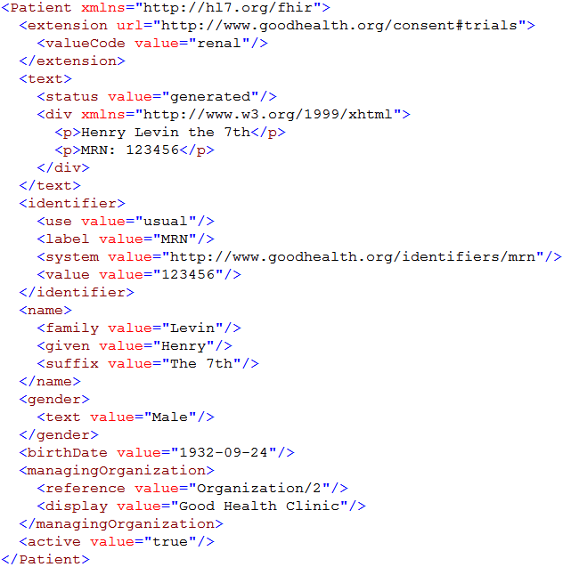
Extension with reference to its definition
Human Readable Summary
Standard Data Content:
MRN
Name
Gender
Date of Birth
Provider
Notes:
System for gender is wrong . . .

Slide 7
Extensions
Managing extensibility is a central problem
Everyone needs extensions, everyone hates them
Alternative is too complex
FHIR tames extensibility
Built in extensibility framework (engineering level)
Define, publish, find extensions
Use them
This tames the overall specification

Slide 8
Current state
7 connectathons (100+ companies)
Multiple reference implementations
Auto-generated interfaces in 5+ languages
Public test servers
Used by IHE, DICOM, ONC, many others
W3C assisting with Semantic Web aspects
1st DSTU to published January
Notes:
Implementation by Epic, Cerner, Mayo, Intermountain, Regenstrief, 20 different countries

Slide 9
FHIR & Ontologies
Current serializations are XML & JSON, but RDF is coming
Every element (core or extension) has a URL that points to its definition
Definition of both data elements and codes can include mappings to other data elements and codes
including broader, narrower, equivalent, etc.
Notes:
Data format doesn’t change when new profiles are added on top

Slide 10
FHIR & Ontologies
Profile instances to be expressed as OWL class models
Allow (partial) validation & reasoning
Exploring exposing RIM mappings using OWL + SPARQL
Detection of duplicate/overlapping elements
Core & extension
Validation of RIM and 21090 alignment

Slide 11
What’s next?
Next DSTU in July, 2015
More resources (Referral, Coverage, etc.)
More capabilities (Publish subscribe, custom operations)
Profiles for CCDA 1.1
Normative in 2017
Good opportunity to ensure that primary care data capture will be well aligned with ontology needs

Slide 12
Follow Up
Read the spec: hl7.org/fhir
Follow #FHIR on Twitter
Shape the specification:
Make comments online (commenting widget in spec)
Try implementing it
Come to the next Connectathon
Come to the next HL7 meeting (Jan in San Antonio)
Contact me
lmckenzie@gevityinc.com

